Slide 1

Automated unit testing
Design for tests and let tests guide your design...

Slide 2

Interfaces for decoupling
Use interfaces to decouple software and look at the roles they play

Slide 3

Look for Expressive Ways to Develop
Domain specific languages, fluent methods...

Slide 4

Tailor your Processes
Develop iteratively and incrementally, be agile...

Slide 5

Supporting An Architecture
Have a guiding metaphor or structure to give context...

Slide 6

Different Dimensions of Development
Think about the social, political *and* technical dimensions of a project

Slide 7

Look for Opportunities...
Great opportunities are often hidden; easy to see in hindsight...

Slide 8
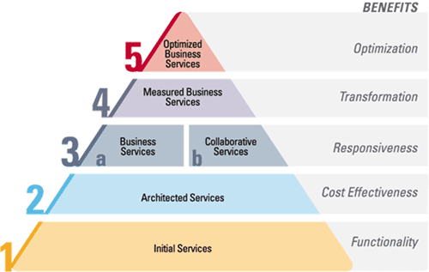
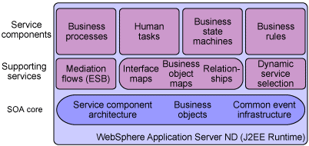

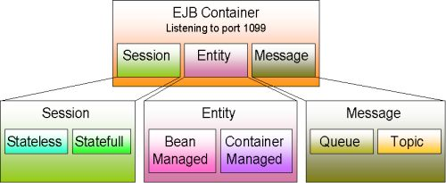
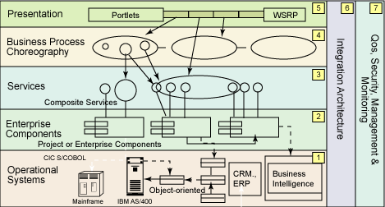
But Beware of Hype...
Review everything critically – form your own opinions...

